Slide 1
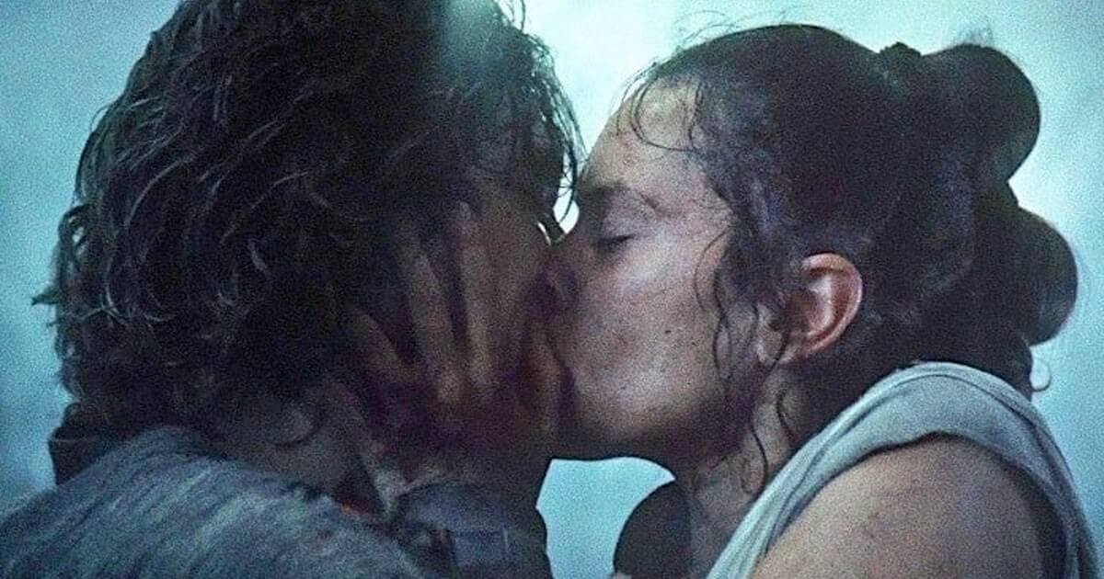
The Embattled Feminine Gaze: A Study in Reylo Discourse
Phoebe Pineda

Slide 2
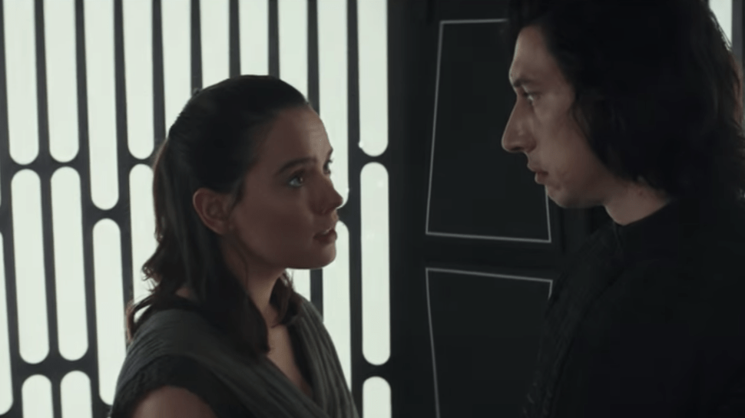
What the heck is Reylo?
Glad you asked!
Relationship (“ship”) between Rey and Kylo Ren from the Star Wars sequel trilogy (VII-IX)
Rey = heroine
Kylo Ren = villain
Very popular…and very controversial

Slide 3
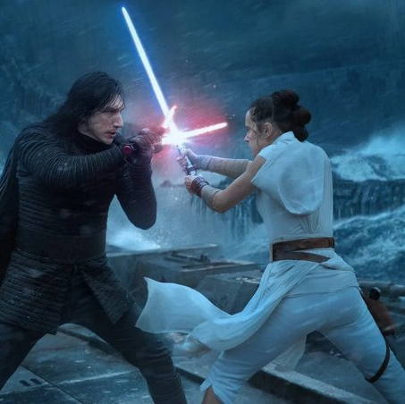
Research Question
Why do people “ship” Reylo?
→
Why is Reylo considered “feminine gaze”?
→
What can the discourse surrounding Reylo tell us about feminine gaze and marginalized spectatorship in fandom?

Slide 4
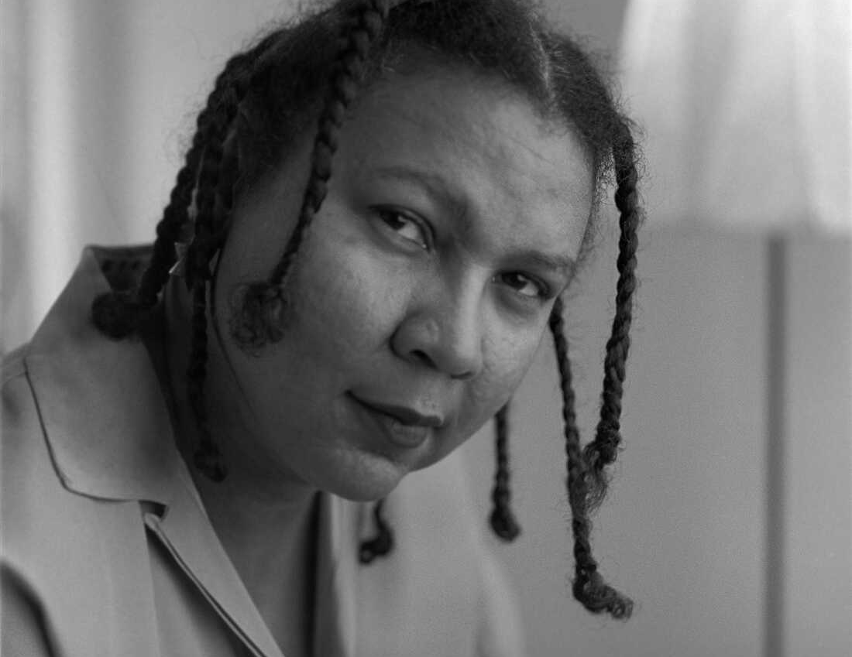
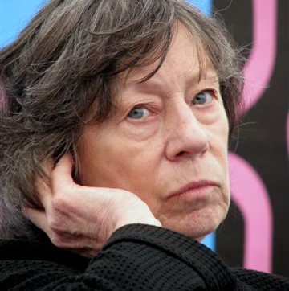
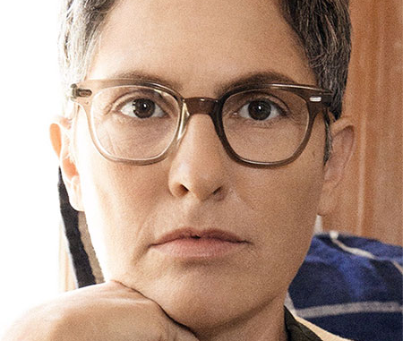
Context and Methodology
Academic precedence
Feminist media scholarship: how does cinematic media replicate oppressive power structures/dynamics?
Cinematic male gaze + cinema as a subconscious extension of the patriarchy (Laura Mulvey)
Black women audiences + the oppositional gaze (bell hooks)
Defining a feminine gaze (Joey Soloway)
Fan studies
Affirmational vs. transformational fandom (obsession_inc)
Lack of attention to race in fandom (Pande, Scott)
Methodology
Blog posts
Published articles
Fan interviews

Slide 5
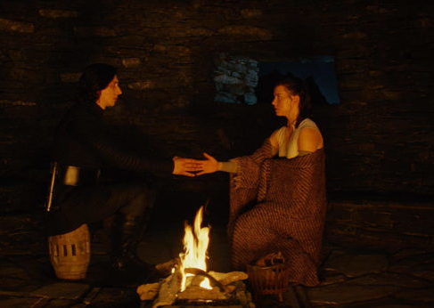
Why Reylo?
A common trope: Enemies-to-lovers
Kylo Ren as Byronic hero + subversive masculinity
Redemptive romance and feminine power fantasy
Power in looking: feminine desire
The heroine’s journey (Murdock)
Romance as character development

Slide 6
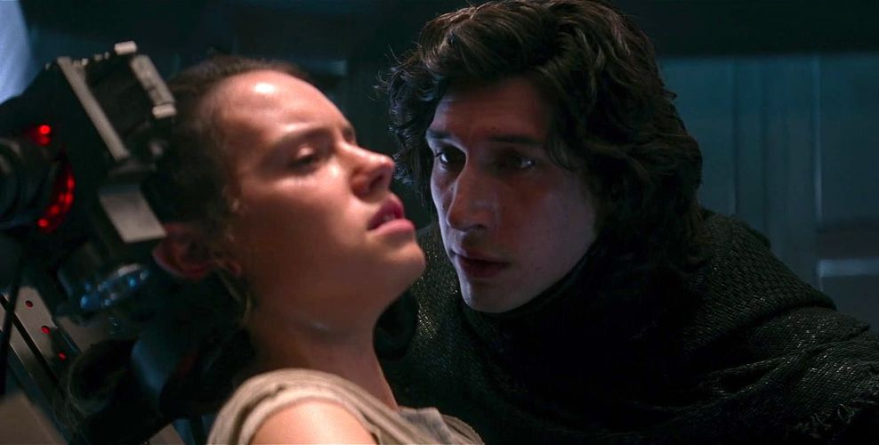
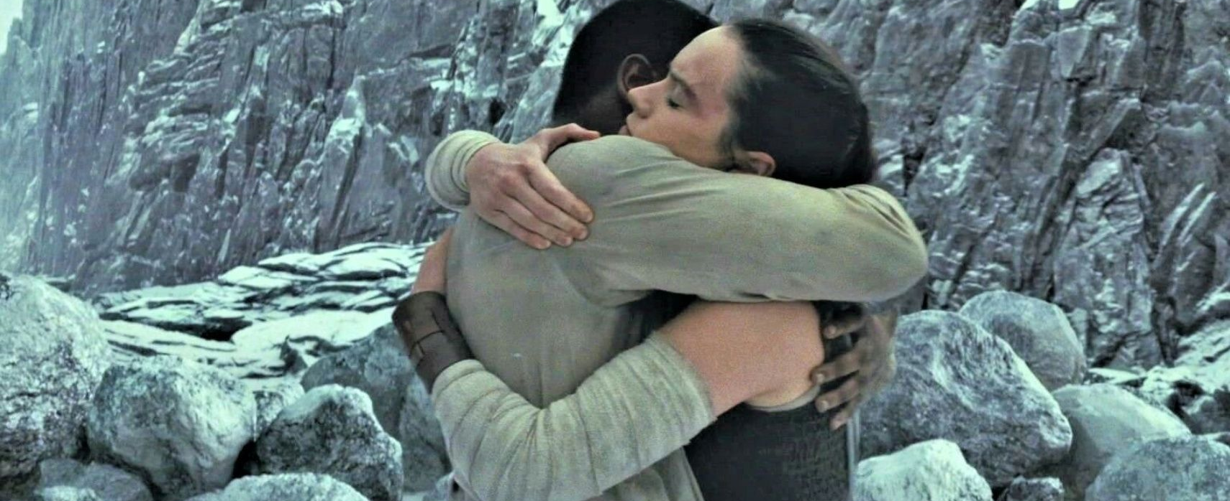
Why not Reylo?
Unhealthy relationship dynamic
Physical violence
Emotional manipulation
Racism + anti-Blackness
“Woobification”
Treatment of Finn
Double standards + glorification of fascist characters

Slide 7
Commentary
Differentiating between misogyny and legitimate criticism
“Think of the children!”
Do “problematic”/violent works geared toward masculine audiences receive as much scrutiny or policing as “problematic”/violent works geared toward feminine audiences?
Fiction vs. reality and the question of escapism
Does fiction inform reality?
Escapism as privilege
Do our definitions of “the feminine gaze” account for intersectionality?
Most Reylo shippers are women…but many Reylo anti-shippers are also women
How lived experience (with abuse, racism, sexuality, etc.) dictates our relationship with media and stories

Slide 8
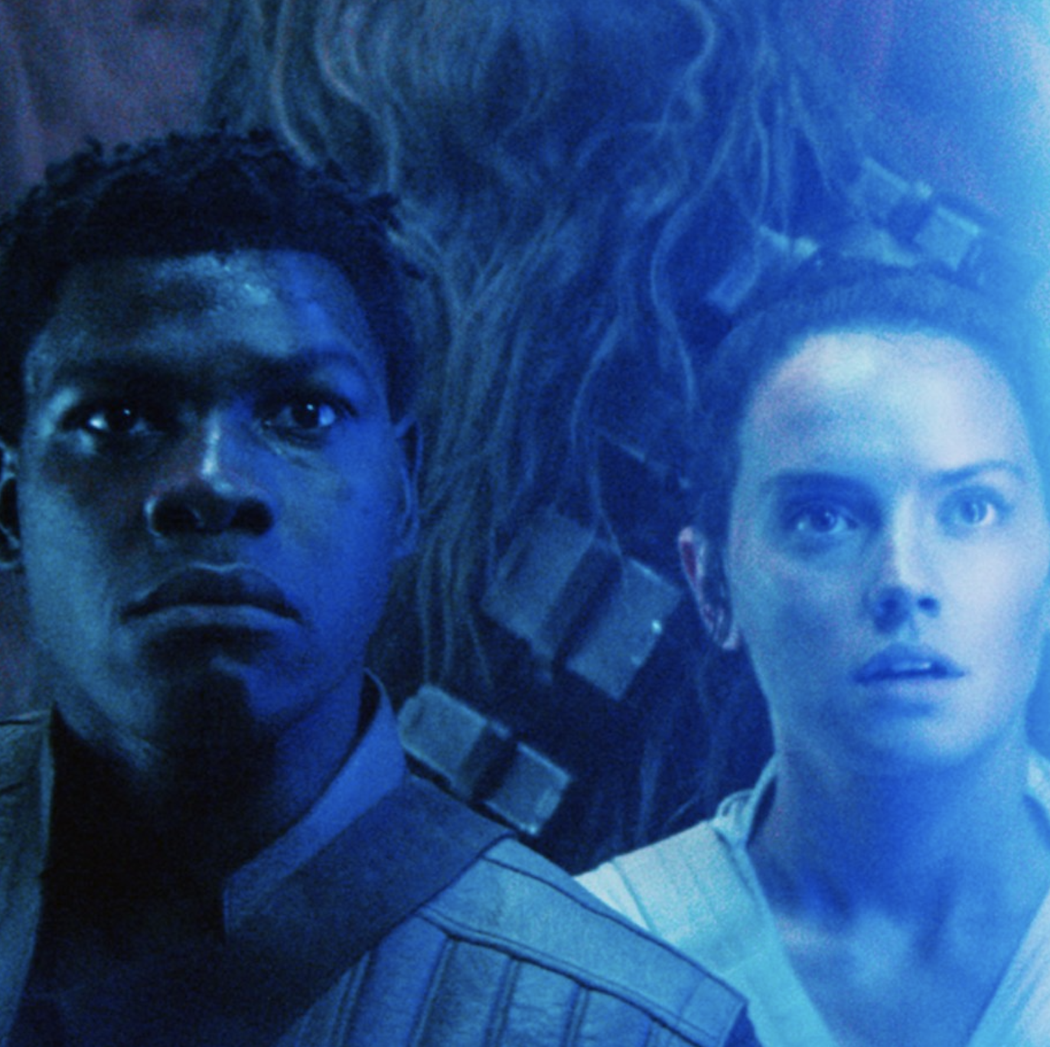
Why does this matter?
Debates over race/racism in media and fandom challenge the perception of fandom as a “safe” + “progressive” space
What some marginalized fans find “liberating” others find troubling
Can fandom be escapism if it reflects real-world biases and beliefs?
The problems with defining a “feminine gaze”
It’s easy to define how spectatorship and media perpetuate inequalities, but how to challenge those structures without perpetuating other inequalities?
Maybe we should conceptualize fem gaze differently – not a single lens, but a prism
Finding nuance in criticism

Slide 9
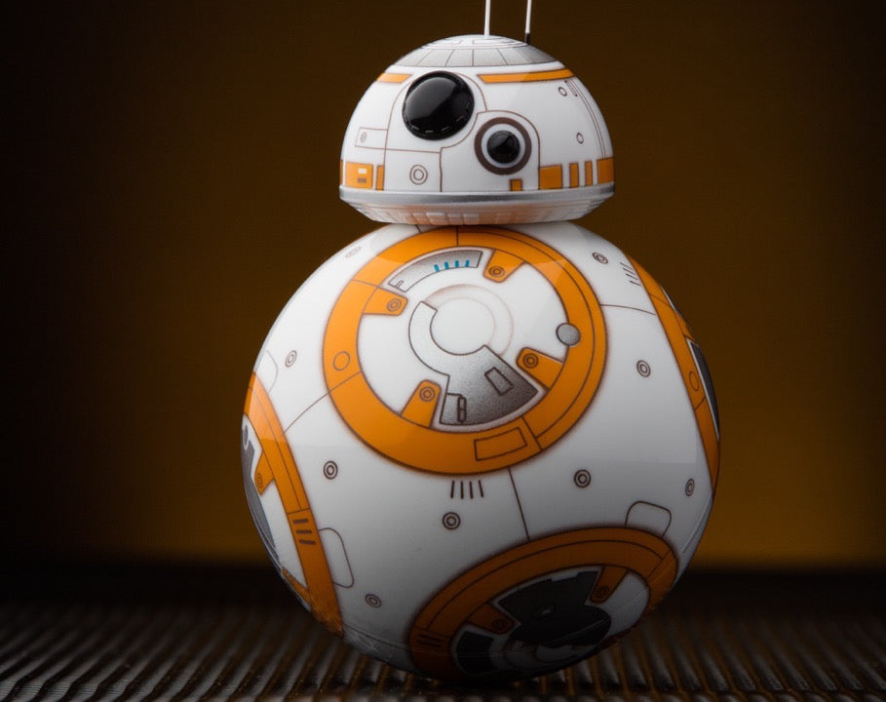
Thanks for listening!

